Slide 1

به نام هستی بخش
Hybrid Meta-Heuristics: LLM-Enhanced Particle Swarm Optimization
ارایه دهنده : محسن حامی
استاد درس : دکتر عباد زاده
درس بهینه سازی فرا ابتکاری
ارایه دوم - پاییز - ۱۴۰۴

Slide 2


Introduction
Methods
Conclusion
Discussion and QA
References
What is Particle Swarm Optimization (PSO)?
The Analogy (The “Bird Flock”):
Imagine a flock of birds flying over a dark field looking for food.
None of the birds know exactly where the food is, but they know how close they are to it.
The Strategy: Each bird follows two simple rules:
Remember the best spot I have found so far (Personal Best).
Fly towards the best spot the whole flock has found so far (Global Best).
Eventually, the whole flock gathers around the food source.
2/24

Slide 3
Introduction
Methods
Conclusion
Discussion and QA
References
How PSO Works: Parameters & Trade-offs
The 3 Key Parameters (The “Knobs”):
Inertia Weight (w):
Definition: How much the particle keeps moving in its previous direction.
Effect: High w = Exploration (flying wildly). Low w = Exploitation (slowing down to search carefully).
Cognitive Coefficient (c1):
Definition: How much the particle trusts its own memory (pbest).
Effect: High c1 encourages independent exploration.
Social Coefficient (c2):
Definition: How much the particle trusts the swarm leader (gbest).
Effect: High c2 makes the swarm converge (cluster) quickly.
3/24

Slide 4
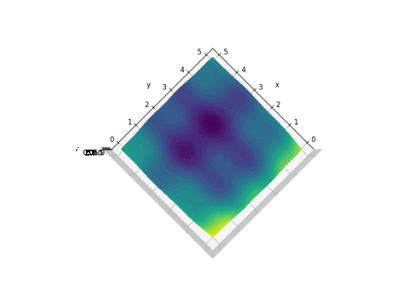
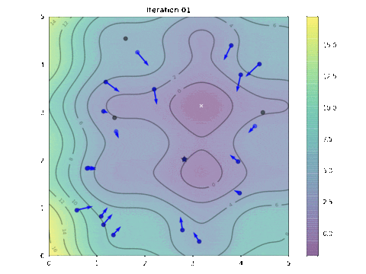
Introduction
Methods
Conclusion
Discussion and QA
References
✅ Pros: Simple to implement, works without complex math (derivatives), effective for discrete numbers (like number of layers).
❌ Cons: Can get stuck in “Local Optima” (finding a good spot, but missing the best spot), and the parameters (w,c1,c2)
Standard PSO often uses a fixed inertia (e.g., w=0.7).
If w is too high, the particles fly past the target and never land (Chaos).
If w is too low, the particles barely move and get stuck in the first hole they find (Stagnation).
4/15

Slide 5


Introduction
Methods
Conclusion
Discussion and QA
References
Today's Presentation Roadmap:
1. Quick Recap: Phase 1 Results & Baseline Paper
2. Phase 2 Objectives: What We Improved
3. New Methods Implemented:
• Task 1: LLM Controls c1/c2 + Particle History
• Task 2: Expanded 5D Search Space
• Task 3: Adaptive Inertia Weight Strategies (AIWPSO)
4. Experimental Results (Regression + Classification)
5. Comparative Analysis: Phase 1 vs Phase 2
6. Conclusions & Future Work
5/24

Slide 6
Introduction
Methods
Conclusion
Discussion and QA
References
📄 Baseline Paper:
Key Contributions of the Paper:
┌─────────────────────────────────────────────────────────────┐
│ 1. First integration of LLM reasoning with PSO │
│ 2. Memory module to track optimization history │
│ 3. Chain-of-Thought prompting for suggestions │
│ 4. Tested on LSTM (Regression) and CNN (Classification) │
└─────────────────────────────────────────────────────────────┘
Paper's Core Idea:
• PSO is good at "exploration" but lacks "reasoning"
• LLM is good at "pattern recognition" but can't optimize
• HYBRID = Best of both worlds
6/24

Slide 7
Introduction
Methods
Conclusion
Discussion and QA
References
Phase 1: Our Implementation of the Baseline
CLASSIFICATION TASK (Waste Sorting - CNN)
════════════════════════════════════════════
METHOD │ LAYERS │ FILTERS │ ACCURACY.│ TIME
────────────────────┼────────┼─────────┼───
Simple PSO │ 3 │ 118 │ 86.91% │ 903s
Vanilla (Improved) │ 1 │ 64 │ 87.74% │ 991s ✓
LLM-Enhanced PSO │ 2 │ 40 │ 87.39% │ 1134s
Phase 1: Our Implementation of the Baseline
REGRESSION TASK (Air Quality - LSTM)
══════════════════════════════════════════════
METHOD │ LAYERS │ NEURONS │ RMSE │ TIME
────────────────────┼────────┼─────────┼───────
Improved PSO │ 6 │ 256 │ 0.02145 │ 460s
LLM-Enhanced PSO │ 2 │ 210 │ 0.02159 │ 344s ✓
═══════════════════════════════════════════════
Key Finding: LLM found a LIGHTER model (2 layers vs 6)
with similar accuracy but 25% FASTER!
7/24

Slide 8
Introduction
Methods
Conclusion
Discussion and QA
References
What Was Missing in Phase 1?
❌ Problem 1: Fixed PSO Parameters
• c1 and c2 were FIXED at 2.0 throughout the search
• No adaptation based on swarm behavior
❌ Problem 2: Limited Search Space
• Only 2 dimensions: Layers & Neurons
• Real models need: Learning Rate, Dropout, Epochs...
❌ Problem 3: Blind Inertia Weight
• Linear decrease from 0.9 → 0.4
• Doesn't respond to actual swarm success/failure
Phase 2 Goal: Address ALL three limitations!
8/24

Slide 9
Introduction
Methods
Conclusion
Discussion and QA
References
Phase 2: Advanced Adaptive Strategies
TASK 1: LLM Controls c1/c2 + Particle History
• LLM analyzes particle velocities in real-time
• Dynamically adjusts c1, c2 to prevent overshooting
• Provides position/velocity history context
TASK 2: Expanded 5D Search Space
• Dimensions: Layers, Neurons, LR, Dropout, Epochs
• Tests LLM effectiveness in high-dimensional space
TASK 3: Adaptive Inertia Weight Strategies
• Based on Nickabadi et al. (2011) paper
• 5 strategies: Linear↓, Linear↑, Random, Success, Rank
9/24

Slide 10
Introduction
Methods
Conclusion
Discussion and QA
References
Task 1: Dynamic Parameter Control via LLM
The Problem with Fixed c1/c2:
High c1/c2 (=2.0) → Particles OVERSHOOT the target
Low c1/c2 (=1.0) → Particles move too SLOWLY
Need: ADAPTIVE adjustment based on swarm state
Our Solution:
1. Track particle POSITIONS and VELOCITIES over time
2. Send this "state history" to the LLM
3. LLM analyzes: "Are velocities too high? Too low?"
4. LLM recommends new c1, c2 values
Example LLM Analysis:
"Velocities in filters dimension are large (jumps of ~50),
causing overshooting. Reducing c1/c2 from 2.0 → 1.6"
10/24

Slide 11
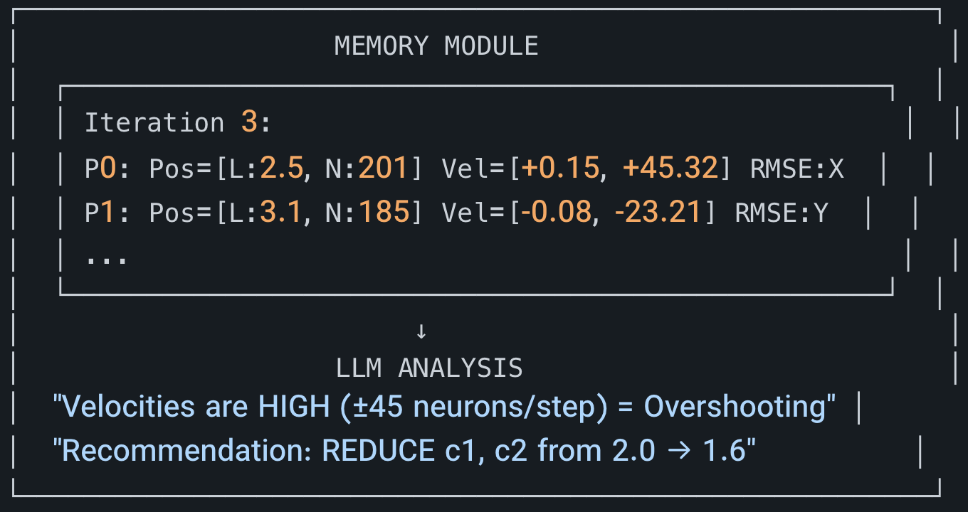
Introduction
Methods
Conclusion
Discussion and QA
References
🧠 Task 1: LLM as "Meta-Controller" INNOVATION: LLM doesn't just suggest WHERE to search, but HOW FAST to search (c1, c2 parameters)
The Logic: • High Velocity → Particles flying past the target → LOWER c1, c2
• Low Velocity → Particles stuck/stagnating → RAISE c1, c2
11/24

Slide 12
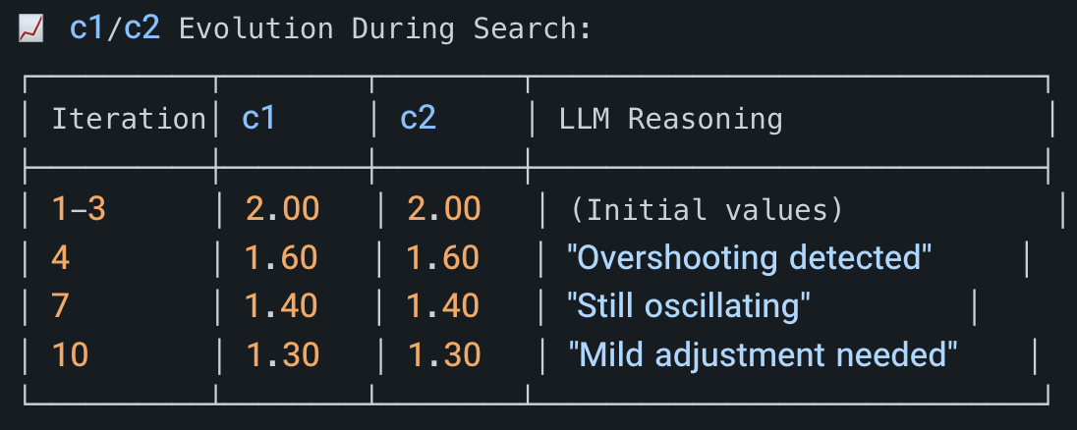
Introduction
Methods
Conclusion
Discussion and QA
References
📊 Task 1 Results: REGRESSION (Air Quality)
LLM-Controlled c1/c2 + Particle History
│ BEST RESULT: L=2, N=201 | RMSE = 0.02150 | Time: 239.5s │
✅ LLM successfully identified velocity patterns
✅ Gradual reduction of c1/c2 stabilized convergence
12/24

Slide 13
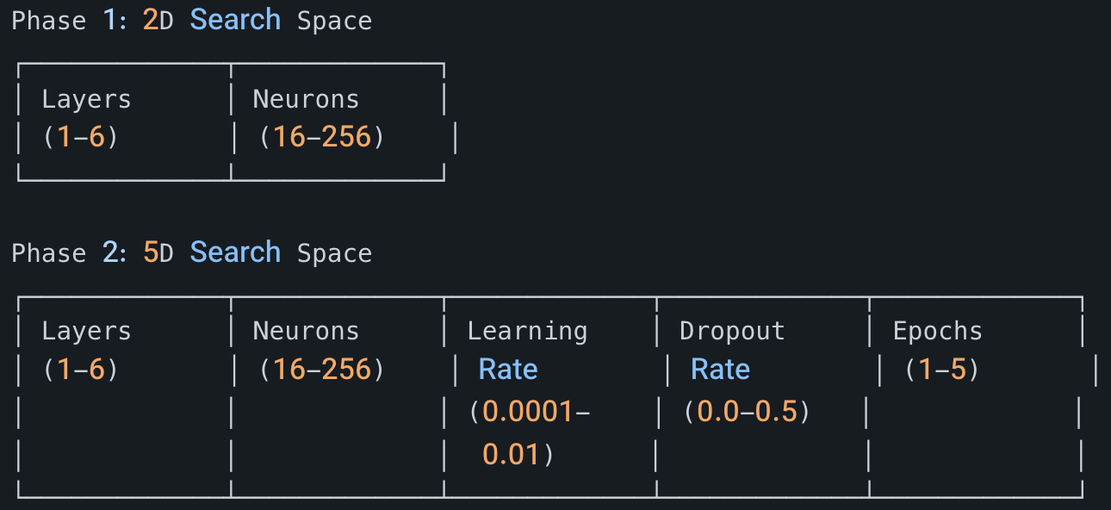
Introduction
Methods
Conclusion
Discussion and QA
References
🔬 Task 2: Higher Dimensional Optimization
🎯 Research Question:
"Does LLM guidance scale to higher-dimensional problems?"
"Can LLM find patterns in 5 interacting variables?"
13/24

Slide 14
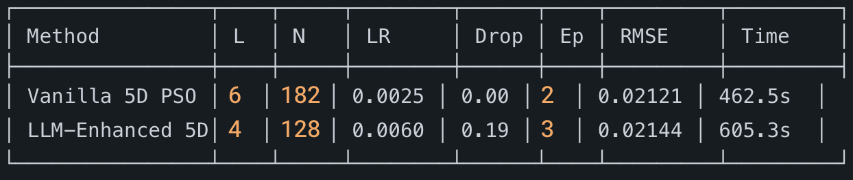
Introduction
Methods
Conclusion
Discussion and QA
References
📊 Task 2 Results: REGRESSION 5D Search
🔍 Analysis:
• Vanilla PSO: Found lowest RMSE but chose Dropout=0.00 (⚠️ Overfitting risk!)
• LLM-Enhanced: Chose Dropout=0.19 (✅ More robust/generalizable model)
📝 LLM Insight (from logs):
"Best configs cluster around 4-5 layers, ~127-155 neurons,
mid-to-low LR (0.0007-0.0062), moderate dropout (0.19-0.35)"
✅ LLM found SAFER configurations even in 5D space
14/24

Slide 15
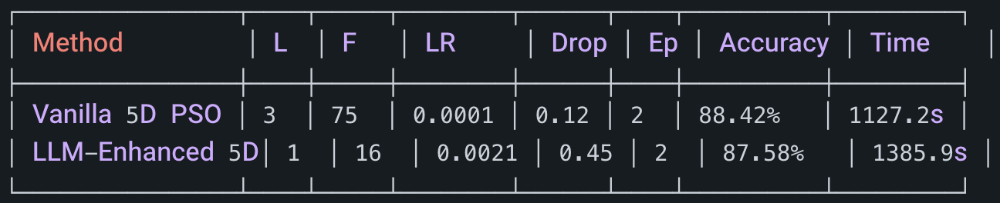
Introduction
Methods
Conclusion
Discussion and QA
References
📊 Task 2 Results: CLASSIFICATION 5D Search
🔍 Interesting Observation:
• Vanilla found a larger model (L=3, F=75) → Higher accuracy
• LLM found the SMALLEST possible model (L=1, F=16) → Still 87.58%!
💡 Insight: LLM prioritizes EFFICIENCY over raw accuracy
(1 Layer, 16 Filters = 10x fewer parameters than 3 Layers, 75 Filters)
15/24

Slide 16
Introduction
Methods
Conclusion
Discussion and QA
References
📊 Task 2 Results: REGRESSION 5D Search
🔍 Analysis:
• Vanilla PSO: Found lowest RMSE but chose Dropout=0.00 (⚠️ Overfitting risk!)
• LLM-Enhanced: Chose Dropout=0.19 (✅ More robust/generalizable model)
📝 LLM Insight (from logs):
"Best configs cluster around 4-5 layers, ~127-155 neurons,
mid-to-low LR (0.0007-0.0062), moderate dropout (0.19-0.35)"
✅ LLM found SAFER configurations even in 5D space
16/24

Slide 17
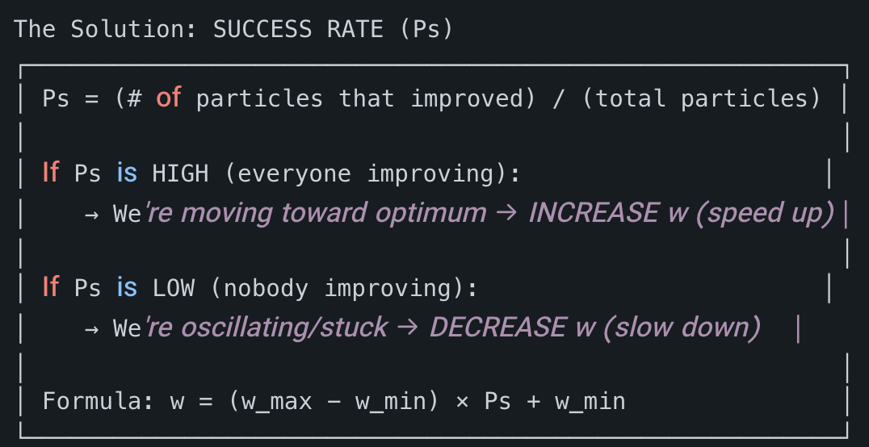
Introduction
Methods
Conclusion
Discussion and QA
References
📚 Task 3: Based on Nickabadi et al. (2011)
"A Novel PSO Algorithm with Adaptive Inertia Weight"
The Problem with Fixed/Linear Inertia:
Linear Decrease: w = 0.9 → 0.4 over time
❌ Flaw: Doesn't care if particles are doing well!
What if we find the target early? Still slows down.
What if we're stuck? Can't speed up again.
17/24

Slide 18
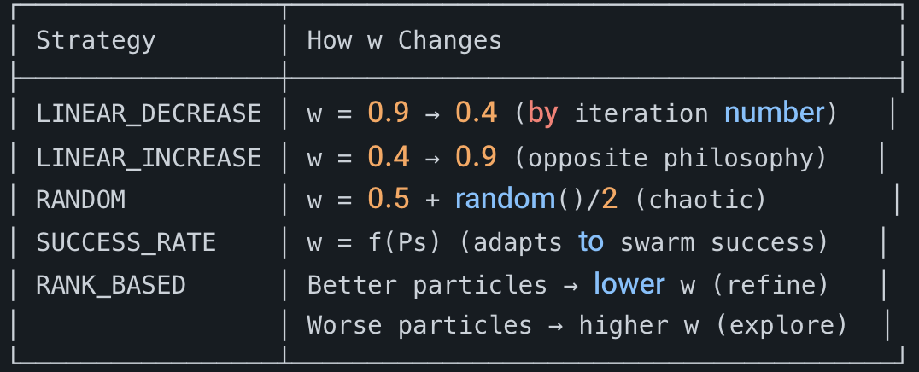
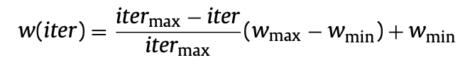
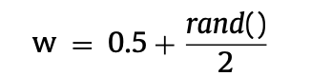
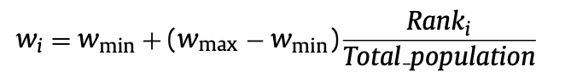
Introduction
Methods
Conclusion
Discussion and QA
References
🧪 Five Inertia Weight Strategies Tested
🎯 Hypothesis: SUCCESS_RATE should win because it uses FEEDBACK from the actual optimization progress
18/24

Slide 19
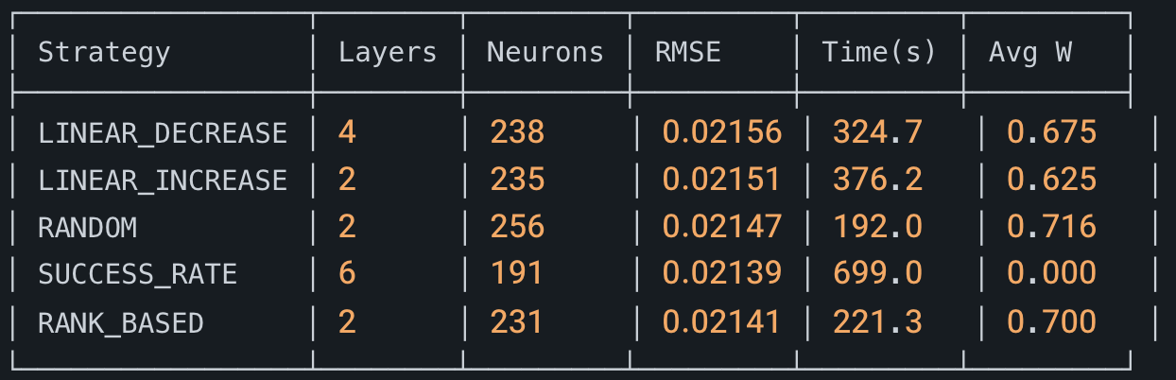
Introduction
Methods
Conclusion
Discussion and QA
References
📊 Task 3 Results: Inertia Strategy Comparison (Regression)
🏆 WINNER: SUCCESS_RATE (RMSE = 0.02139)
📈 Ranking by RMSE:
1. SUCCESS_RATE : 0.02139 ⭐ BEST
2. RANK_BASED : 0.02141
3. RANDOM : 0.02147
4. LINEAR_INCREASE: 0.02151
5. LINEAR_DECREASE: 0.02156
19/24

Slide 20
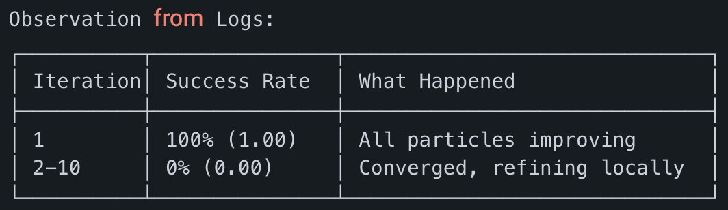
Introduction
Methods
Conclusion
Discussion and QA
References
🔍 Analysis: Why SUCCESS_RATE Achieved Best RMSE
The Mechanism:
• After iteration 1, Success Rate dropped to 0%
• This means w = (1.0 - 0.0) × 0.0 + 0.0 = 0.0
• Particles had ZERO momentum → Pure local refinement
• Result: Very precise convergence to L=6, N=191
⚠️ Trade-off: Took longest time (699s) due to slow movement
✅ Benefit: Achieved lowest error (0.02139)
20/24

Slide 21
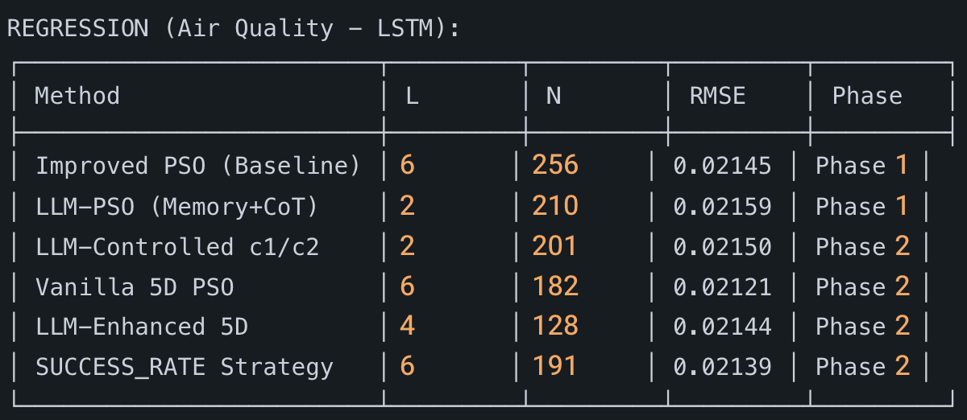
Introduction
Methods
Conclusion
Discussion and QA
References
📊 MASTER COMPARISON: All Methods Across All Tasks
REGRESSION (Air Quality - LSTM):
🏆 Best Overall: Vanilla 5D PSO (0.02121)
🏆 Best Adaptive: SUCCESS_RATE (0.02139)
21/24

Slide 22
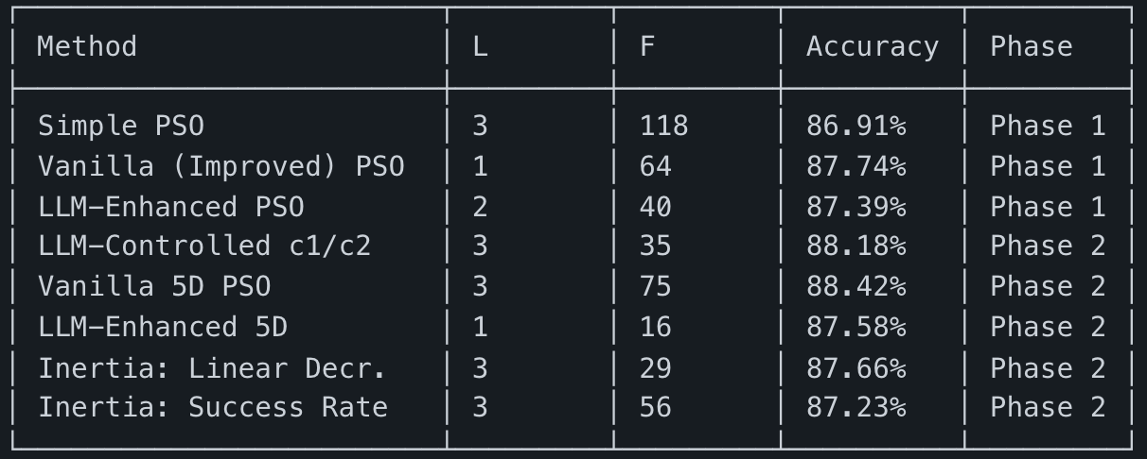
Introduction
Methods
Conclusion
Discussion and QA
References
📊 CLASSIFICATION Summary (Waste Sorting - CNN)
🏆 Best Overall: Vanilla 5D PSO (88.42%)
🏆 Best LLM Method: LLM-Controlled c1/c2 (88.18%)
📈 Improvement: Phase 1 Best (87.74%) → Phase 2 Best (88.42%)
= +0.68% accuracy improvement
22/24

Slide 23
Introduction
Methods
Conclusion
Discussion and QA
References
💡 Key Insights from Phase 2
1️⃣ LLM CAN Control PSO Dynamics (Not Just Positions)
• Successfully detected "overshooting" from velocity patterns
• Gradual c1/c2 reduction (2.0 → 1.4) improved convergence
• Classification accuracy improved: 87.39% → 88.18%
2️⃣ Higher Dimensions Need More Guidance
• 5D search space is complex
• LLM provides valuable "safety" insights (e.g., recommending dropout)
• But pure PSO can still find good solutions faster
3️⃣ Success-Rate Inertia is Powerful
• Adapts to actual optimization progress
• Achieved lowest RMSE (0.02139) in regression
• Confirms theory from Nickabadi et al. (2011)
4️⃣ LLM Prioritizes Efficiency Over Raw Performance
• Consistently finds SMALLER models
• Example: L=1, F=16 (LLM) vs L=3, F=75 (Vanilla) in 5D classification
23/24

Slide 24
Introduction
Methods
Conclusion
Discussion and QA
References
📝 Conclusions
✅ Phase 2 Successfully Extended LLM-PSO Framework
Key Achievements:
1. Demonstrated LLM can control PSO PARAMETERS (c1, c2), not just positions
2. Validated Success-Rate Inertia as best adaptive strategy (RMSE: 0.02139)
3. Improved classification accuracy from 87.74% to 88.42%
4. Showed LLM guidance scales to 5D search spaces
The hybrid approach leverages:
• PSO's exploration capability
• LLM's semantic understanding
• Adaptive strategies' responsiveness
24/24

Slide 25
thank for your attention QA
Introduction
Methods
Conclusion
Discussion and QA
References

Slide 26
References : S. Hameed, B. Qolomany, S. B. Belhaouari, M. Abdallah, J. Qadir and A. Al-Fuqaha, "Large Language Model Enhanced Particle Swarm Optimization for Hyperparameter Tuning for Deep Learning Models," in IEEE Open Journal of the Computer Society, vol. 6, pp. 574-585, 2025, doi: 10.1109/OJCS.2025.3564493. A. Nickabadi, M. M. Ebadzadeh and R. Safabakhsh, "DNPSO: A Dynamic Niching Particle Swarm Optimizer for multi-modal optimization," 2008 IEEE Congress on Evolutionary Computation (IEEE World Congress on Computational Intelligence), Hong Kong, China, 2008, pp. 26-32, doi: 10.1109/CEC.2008.4630771. keywords: {Evolutionary computation;PSO;multi-modal function optimization niching;dynamic;DNPSO}, A. Nickabadi, M. M. Ebadzadeh, and R. Safabakhsh, “A novel particle swarm optimization algorithm with adaptive inertia weight,” Applied Soft Computing, vol. 11, no. 4, pp. 3658–3670, Jun. 2011, doi: 10.1016/j.asoc.2011.01.037.
Introduction
Methods
Conclusion
Discussion and QA
References

